Slide 1




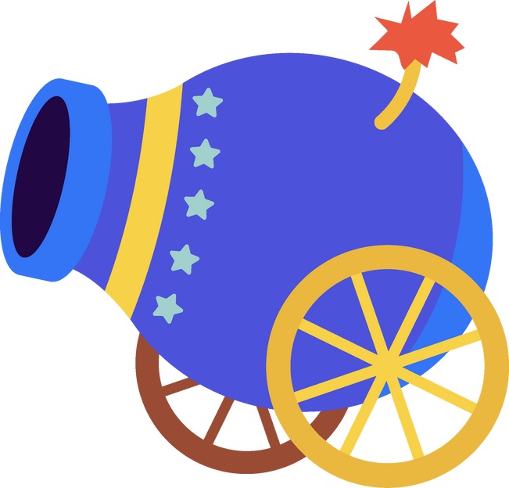
LIFE STORIES AND PERSONALITIES
Start Now!
BINGO!

Slide 2
INTRODUCTION
  Distribute Bingo Grids: Each student receives a 5×5 Bingo grid (teachers can provide pre-printed sheets or guide students to draw the grid on paper).
  Vocabulary Preparation: Below is a list of 25 words related to the topic: Life Stories and Personalities.
  Select and Fill in Words: Students may freely choose any 25 words from the list and fill them into the 25 squares on their Bingo grid (one word per square).
  Read the Clues: The teacher will read out definitions, examples, or synonyms for each vocabulary word in turn.
  Students look for and mark (check, color in, etc.) the corresponding word on their grid if it’s present.
  How to Win: When a student has 5 marked squares in a row (horizontal, vertical, or diagonal), they must shout “BINGO!” and raise their hand to report.

Slide 3
1 | achievement | 10 | charity | 19 | fortune
2 | influence | 11 | determine | 20 | philanthropy
3 | talented | 12 | motivate | 21 | inspiration
4 | distinguished | 13 | dedicated | 22 | fame
5 | persevere | 14 | memorable | 23 | acknowledge
6 | reputation | 15 | innovate | 24 | failure
7 | generosity | 16 | legacy | 25 | prosperous
8 | hospitality | 17 | humble
9 | overcome | 18 | ambition

Slide 4
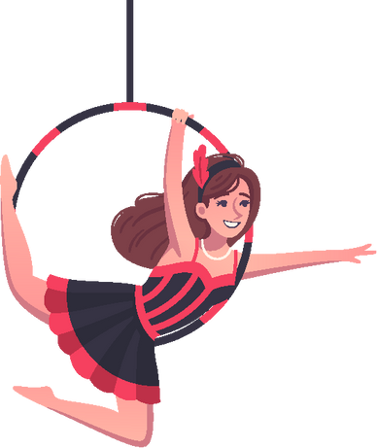
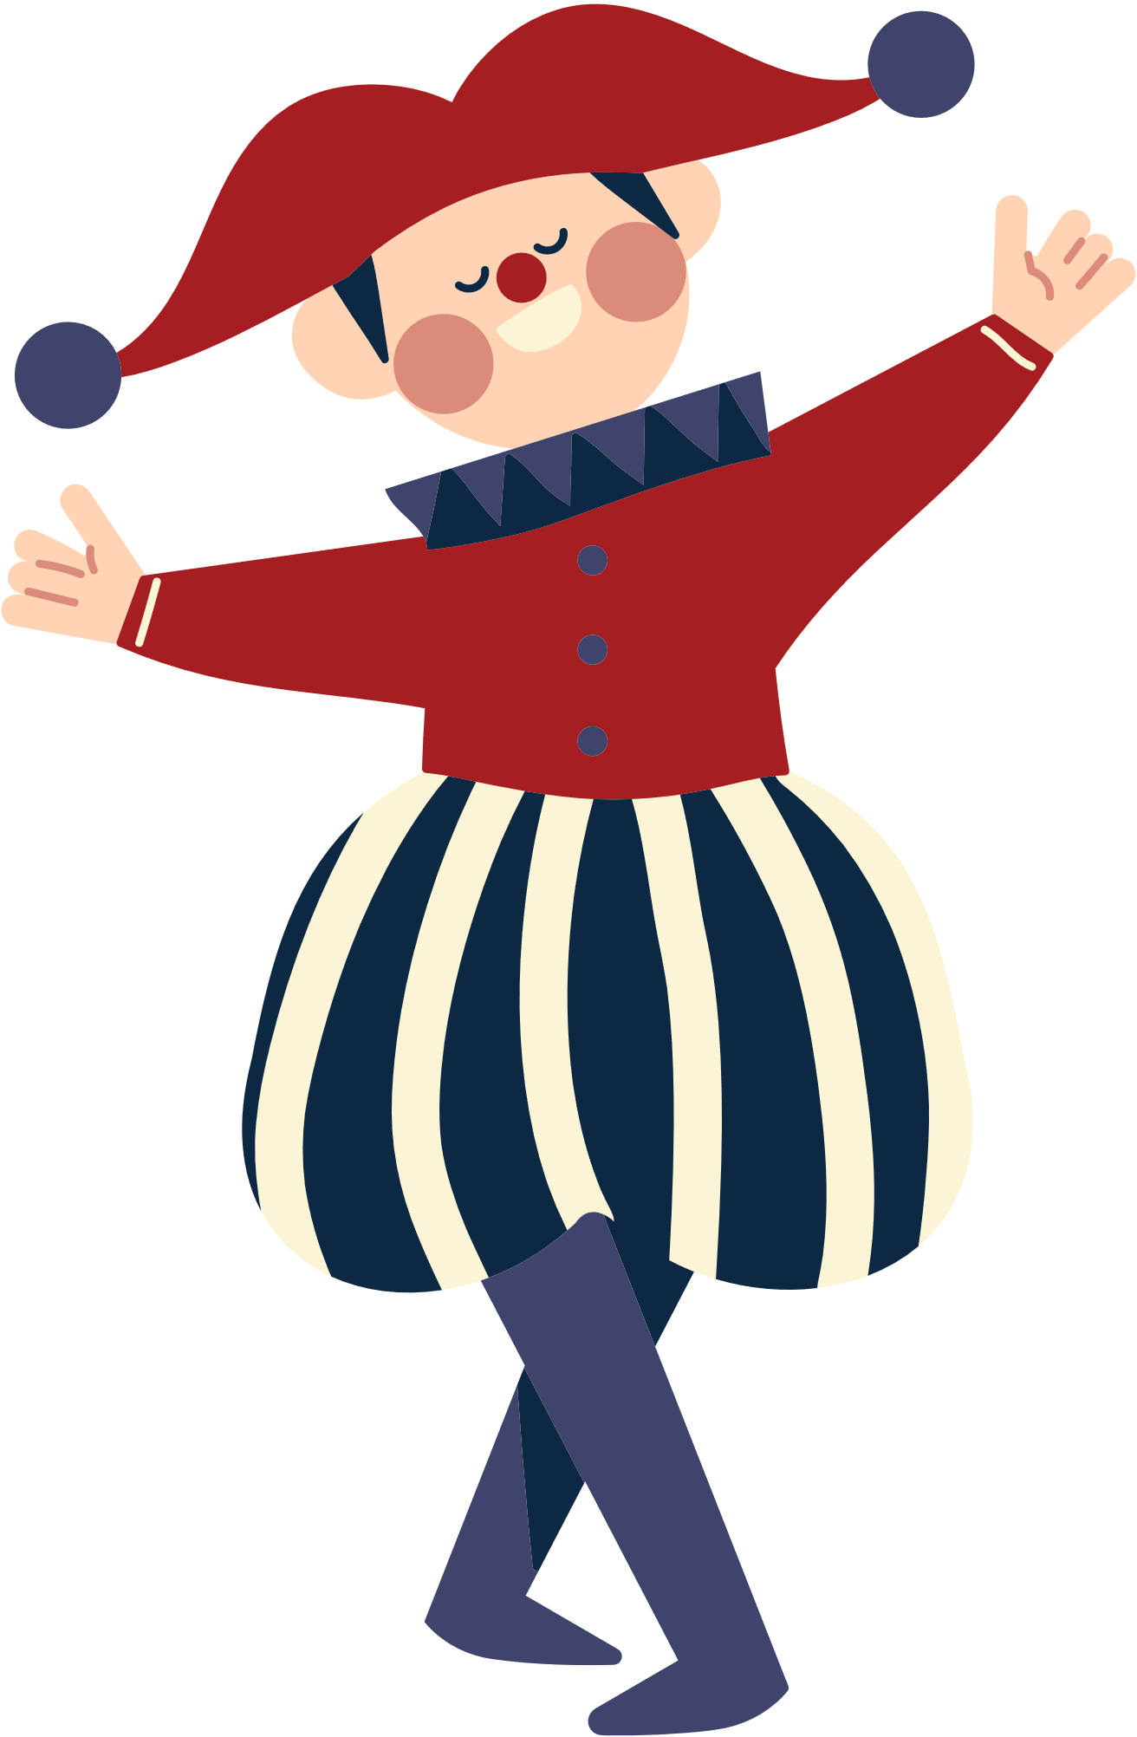
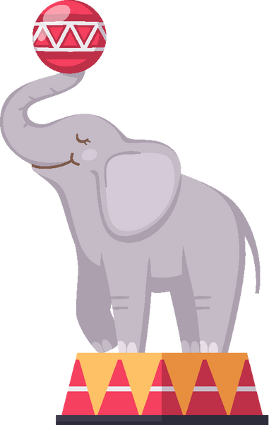
B
I
N
G
O
2
16
32
46
61
4
19
36
49
63
9
24
free
51
65
13
29
40
54
73
14
30
43
59
74

Slide 5

LET’S PLAY
BINGO!

Slide 6
CLUE
1. Definition
  Clue: The ability to stay determined despite difficulties.
2. Synonym
  Clue: Well-known, famous.
3. Example
  Clue: She donated half of her salary to orphanages, showing her …
4. Antonym
  Clue: The opposite of success.
5. Example
  Clue: With his fearless leadership, he built a lasting … that people still admire.
  Answer: legacy

Slide 7
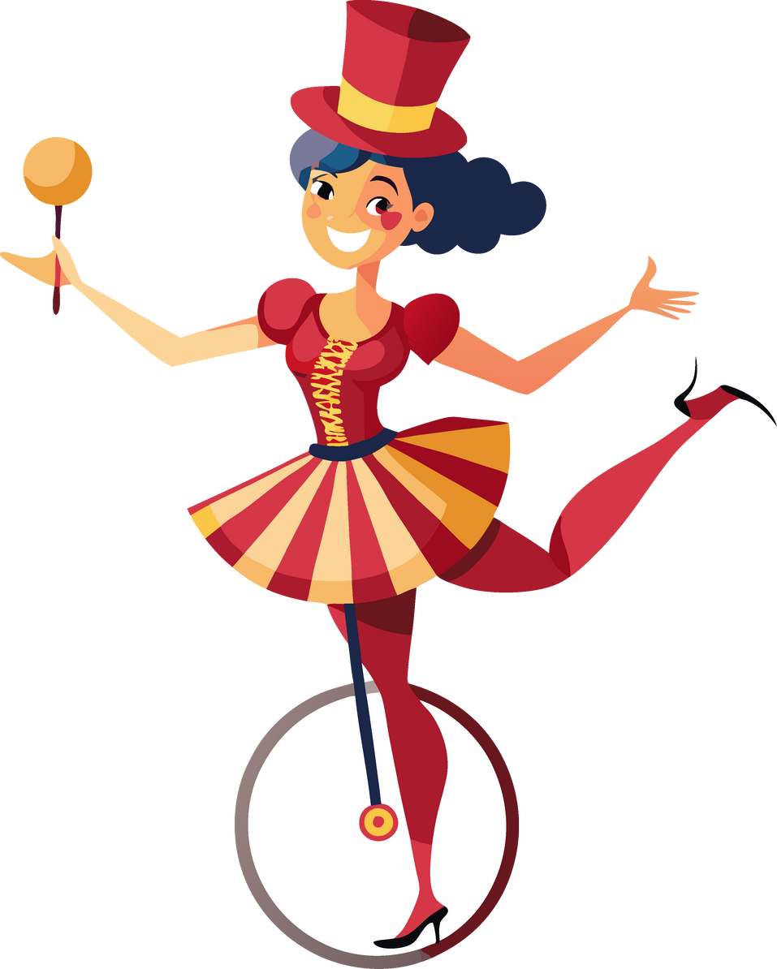
OUR WINNER IS...

Slide 8
THANK YOU
FOR PLAYING!

