Slide 1
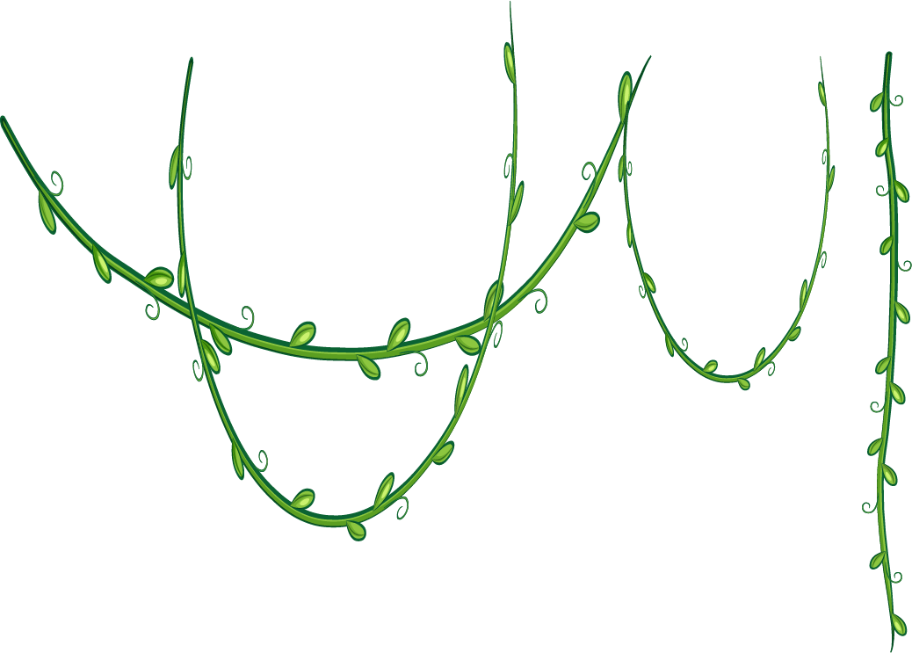









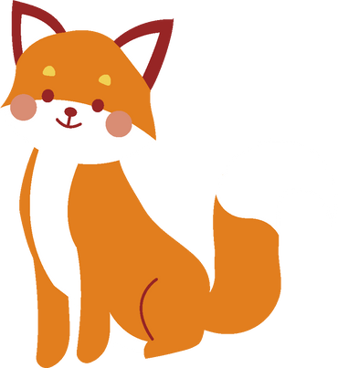
Animal
Trivia Quiz
Let’s Play!

Slide 2



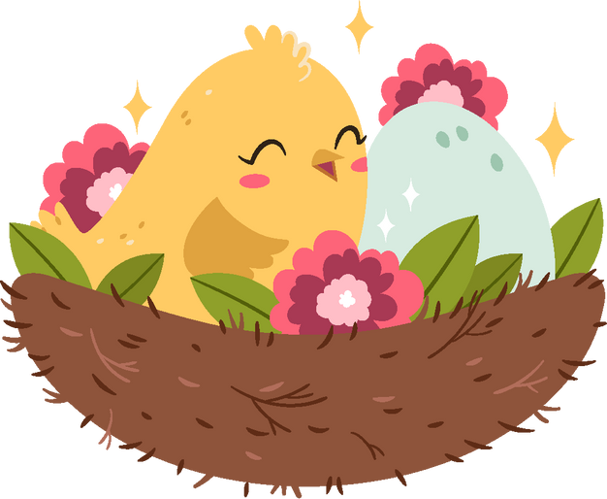
Answer the Question
Which mammal is known to lay eggs?

Slide 3

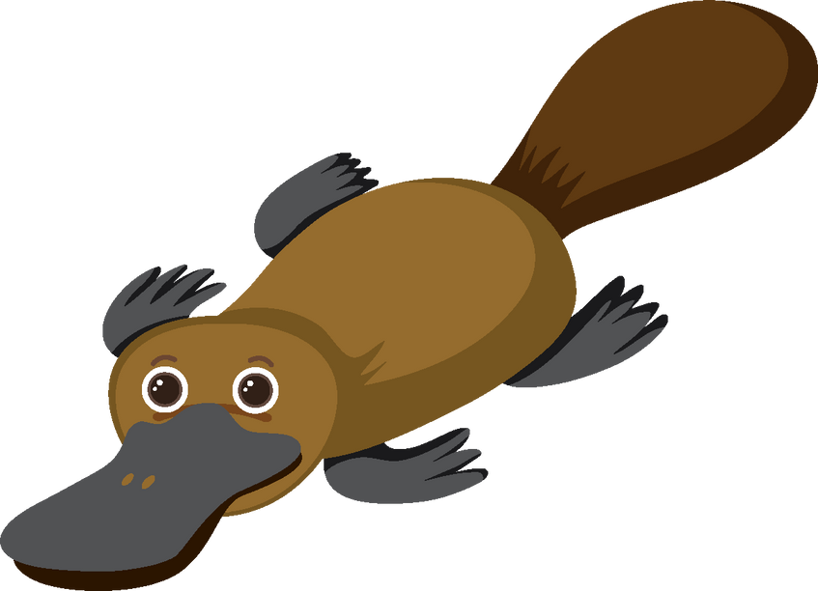


This Answer is
Platypus

Slide 4

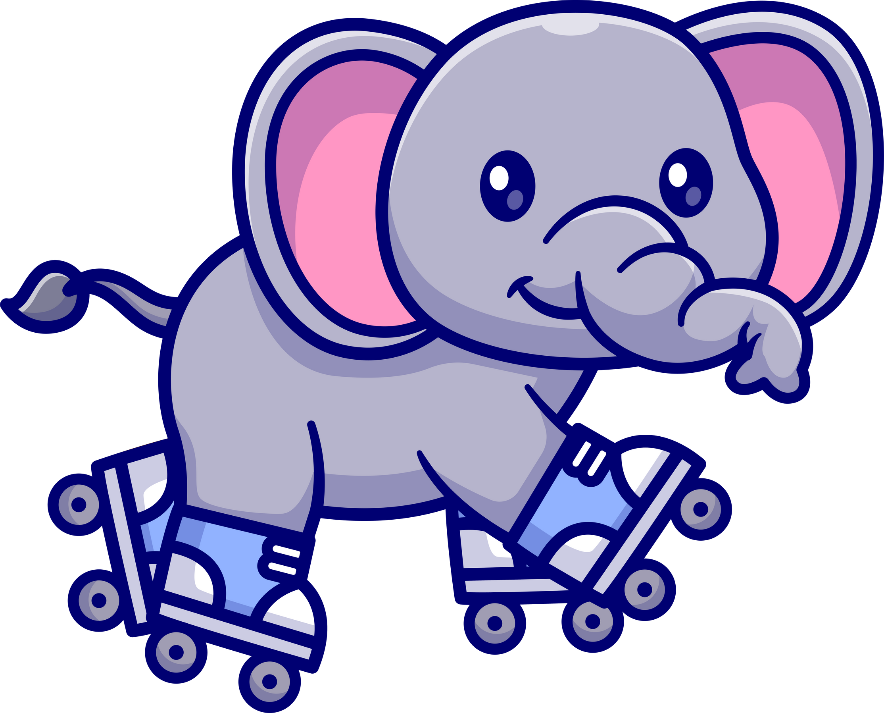

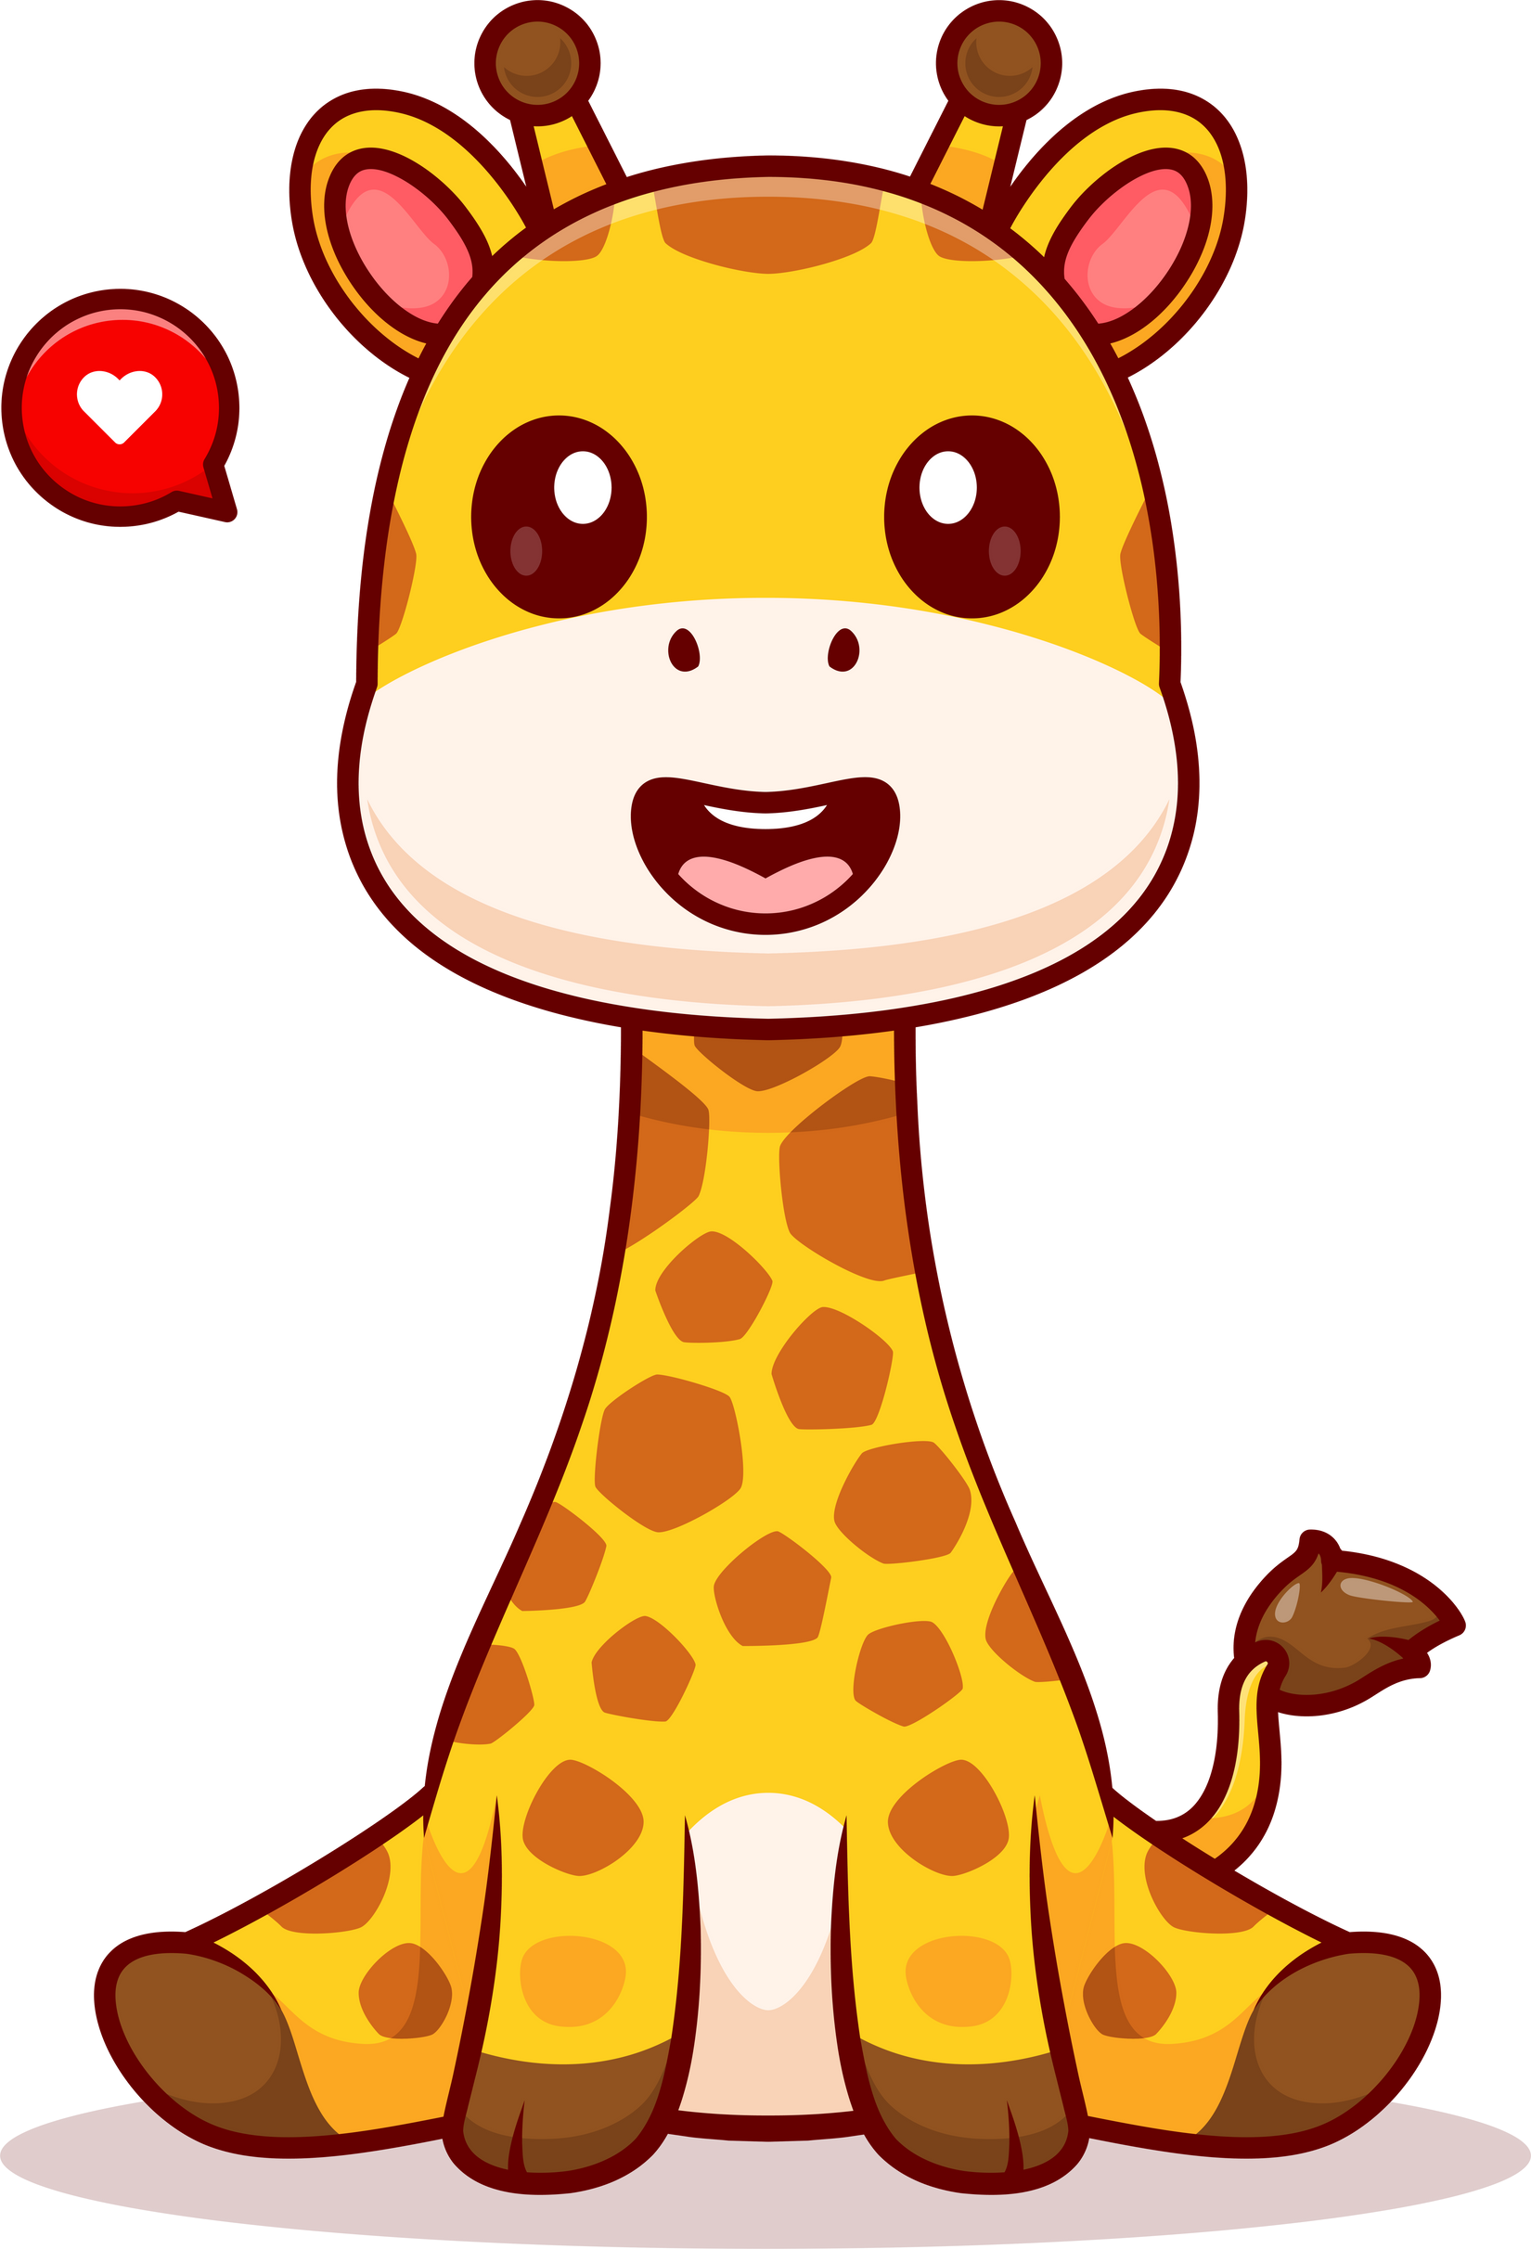


Answer the Question
Which of these animals is the largest?
A) Elephant
B) Blue Whale
C) Giraffe

Slide 5
Answer the Question
Blue Whale

Slide 6
Answer the Question
Which bird has colorful feathers and a beautiful tail?
A) Flamingo
B) Peacock
C) Penguin
D) Eagle

Slide 7
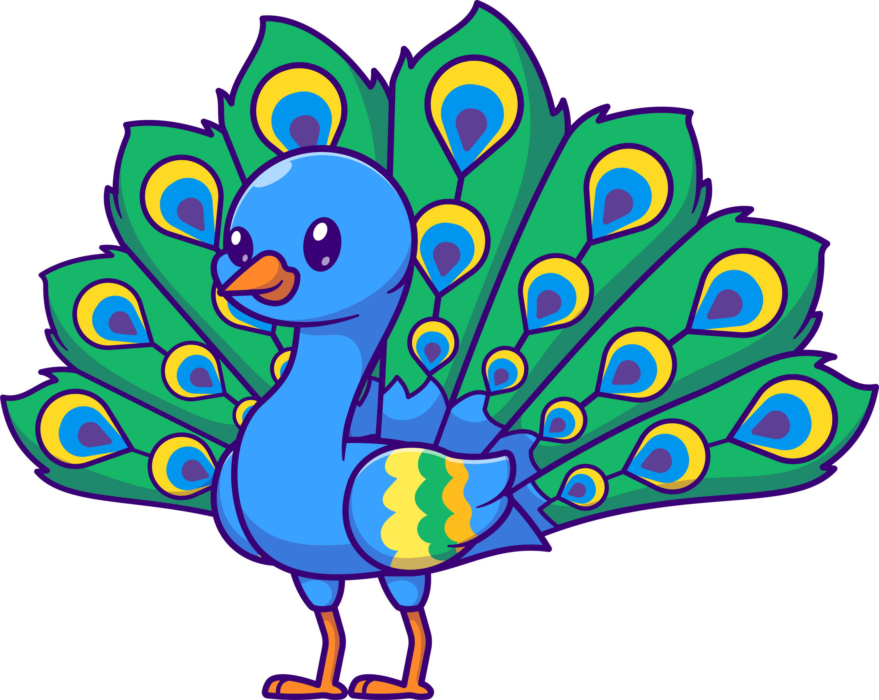
Answer the Question
Peacock

Slide 8




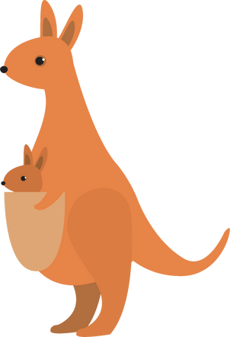
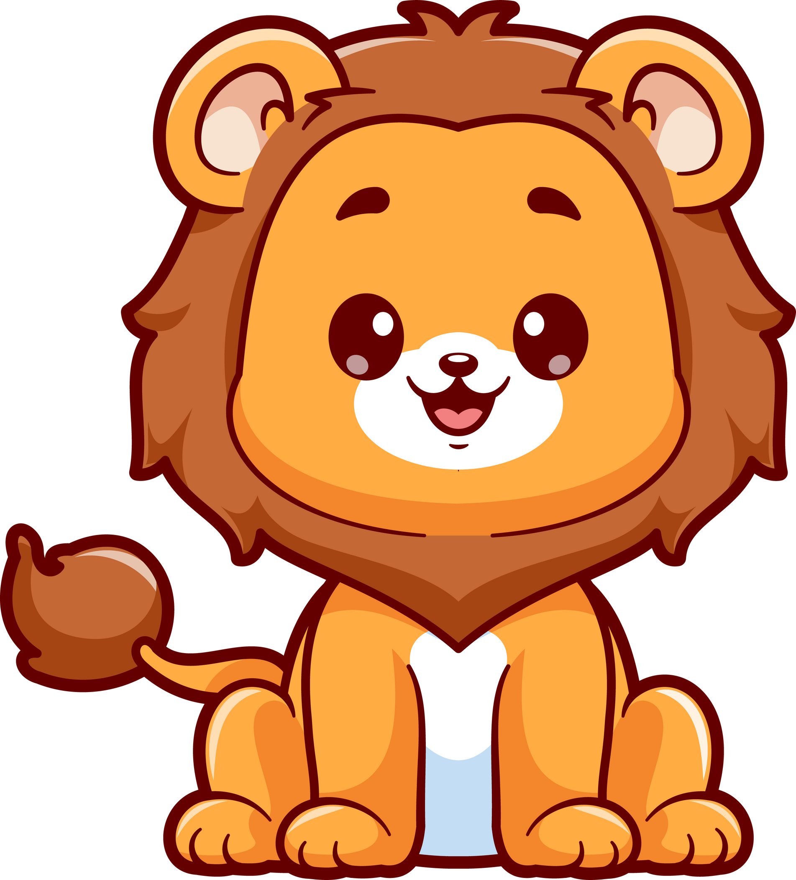



Match the animal names with the correct pictures.
Lion
Penguin
Kangaroo
Dolphin

Slide 9
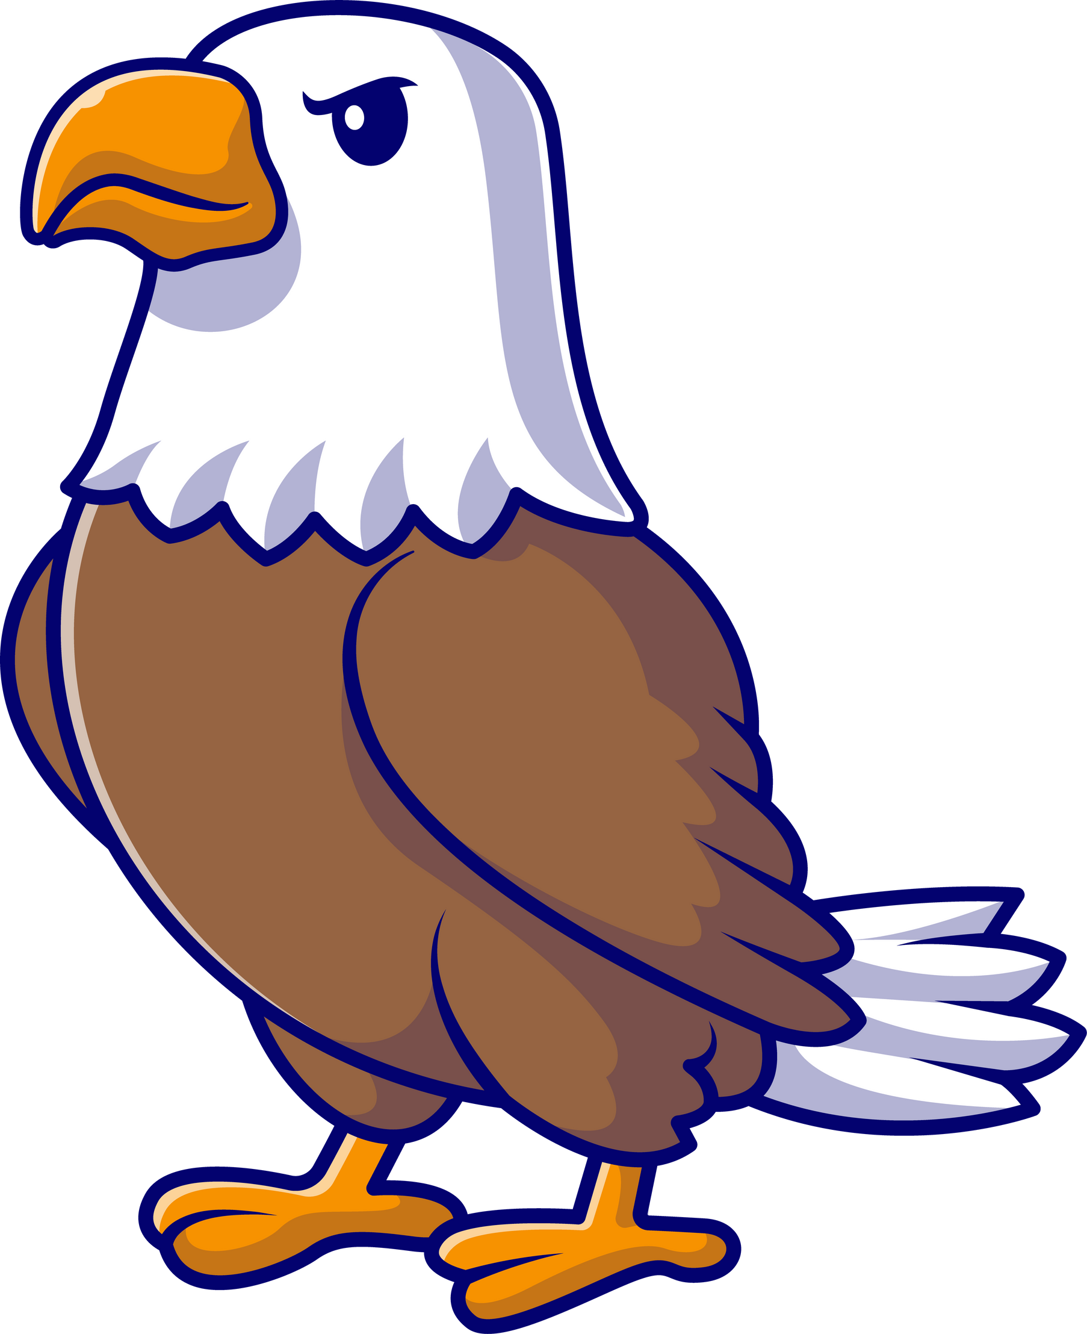

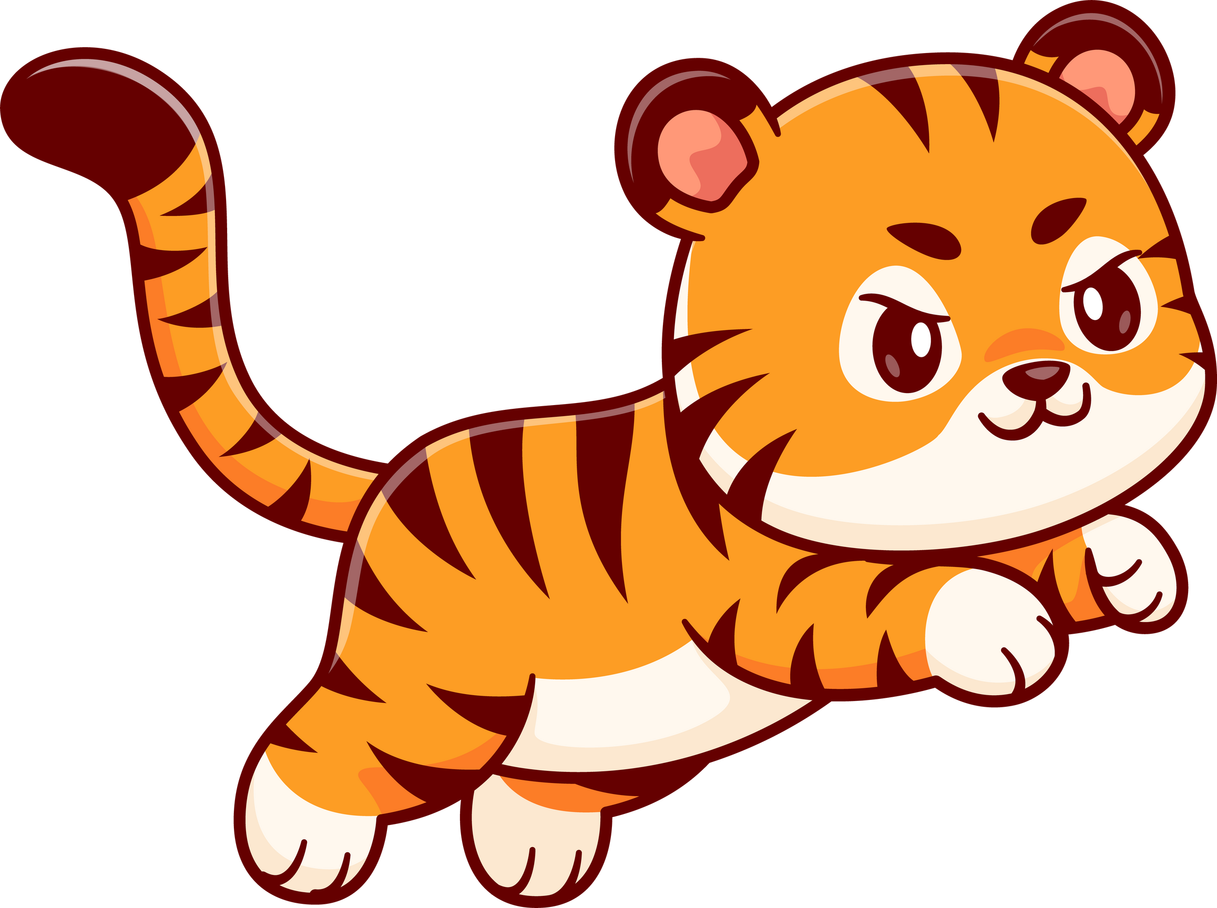
Match the animal names with the correct pictures.
Elephant
Tiger
Shark
Eagle

Slide 10
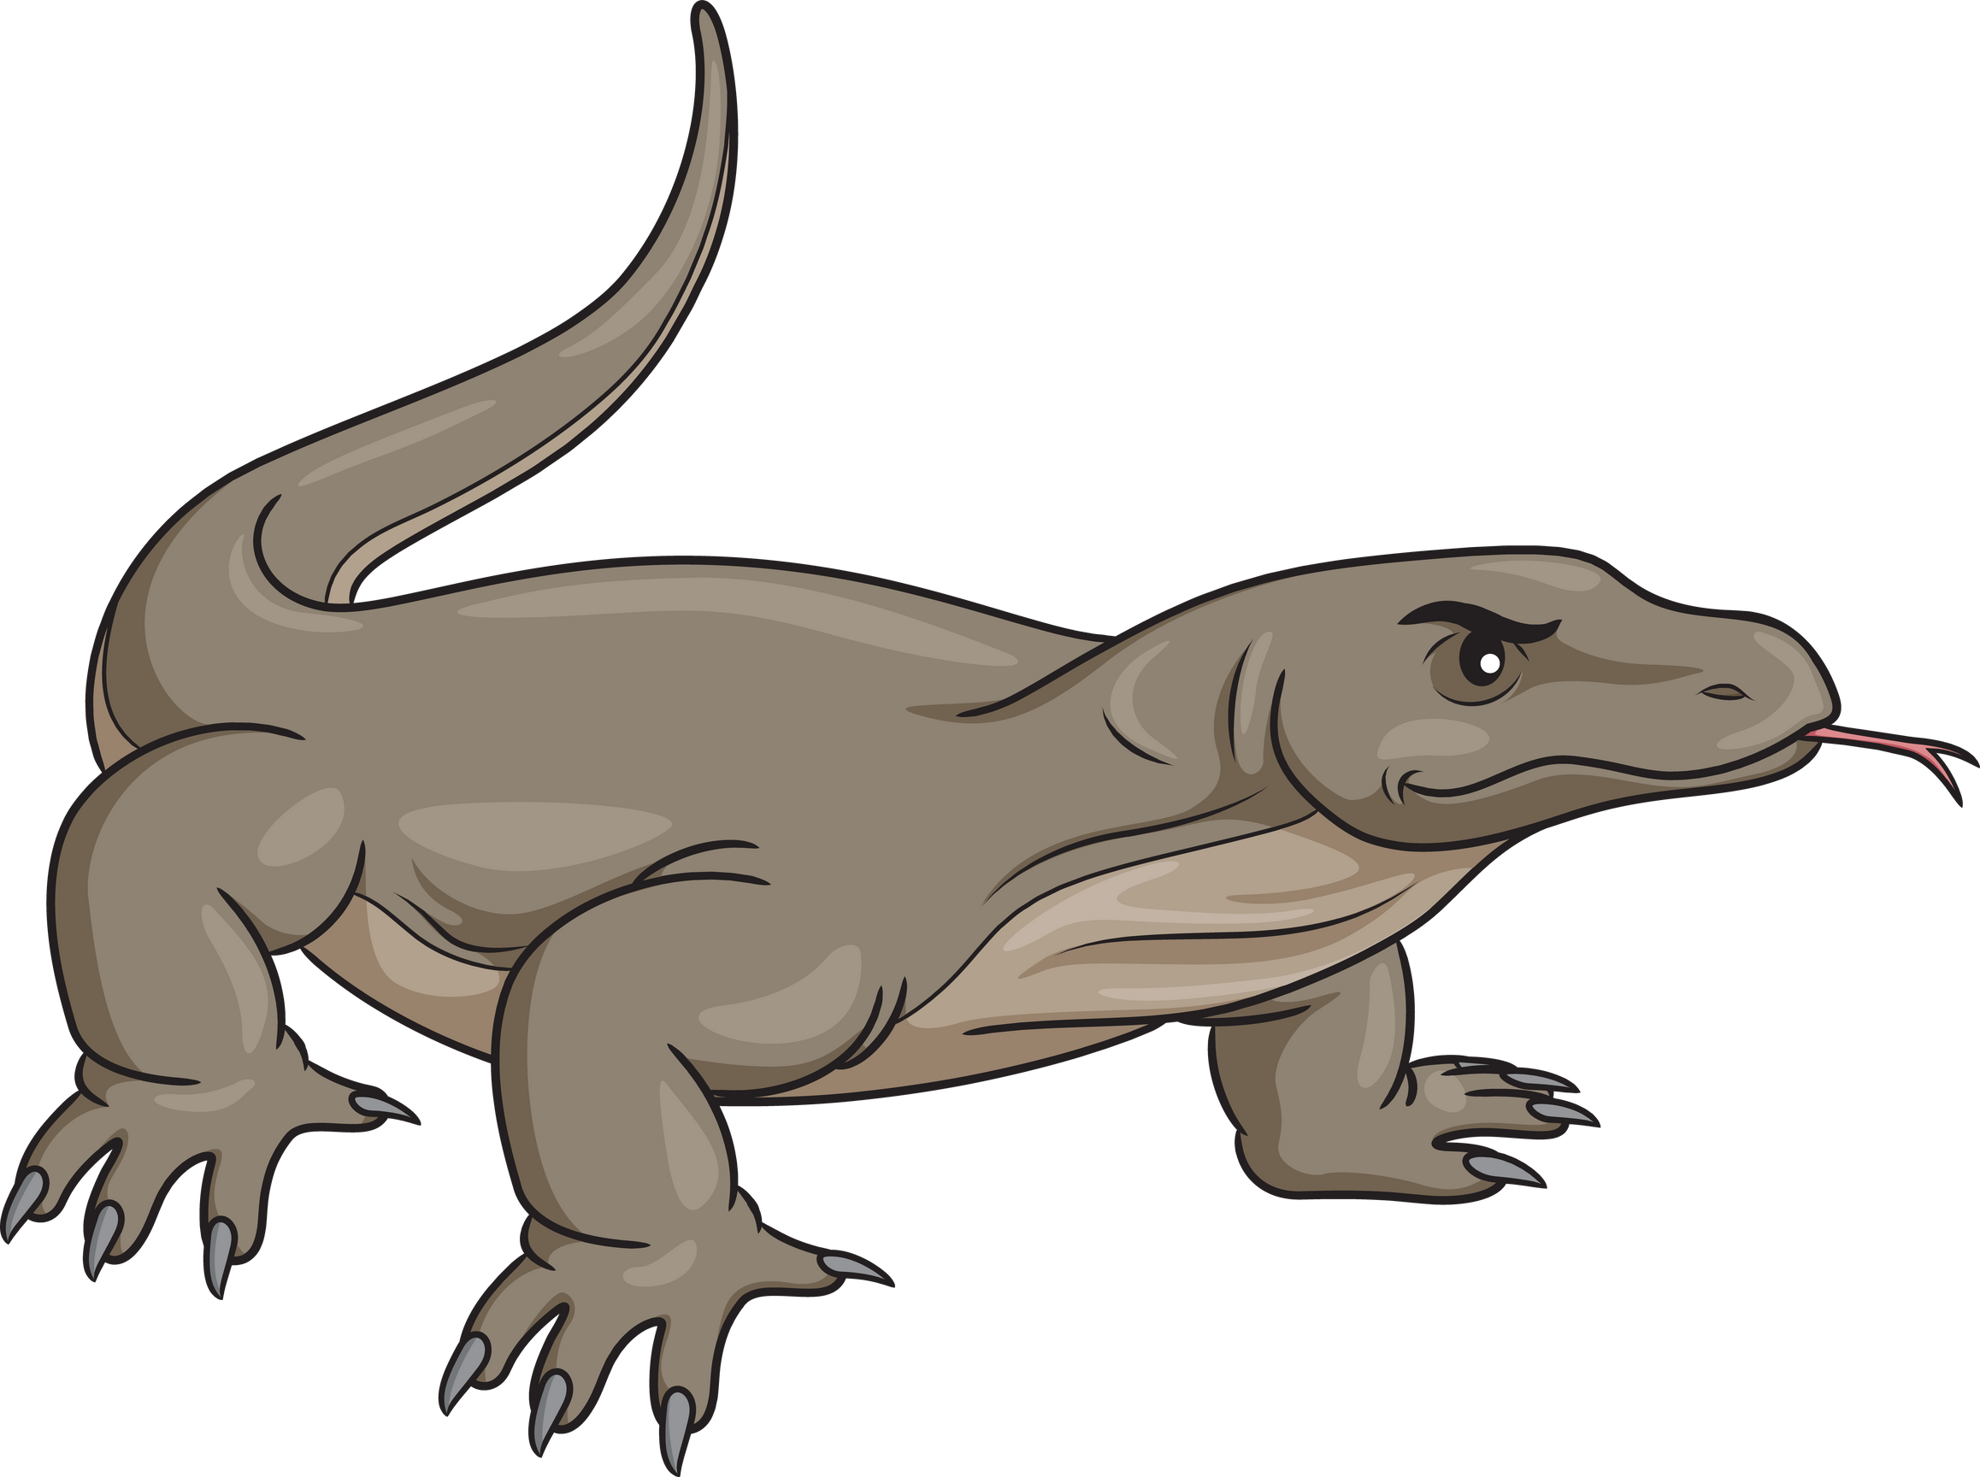
Answer the Question
What type of animal is a Komodo Dragon?
A) Reptile
B) Amphibian

Slide 11
Answer the Question
Komodo is a type of reptile

Slide 12
Thanks for Playing

