Slide 1


Present Continuous Tense

Slide 2
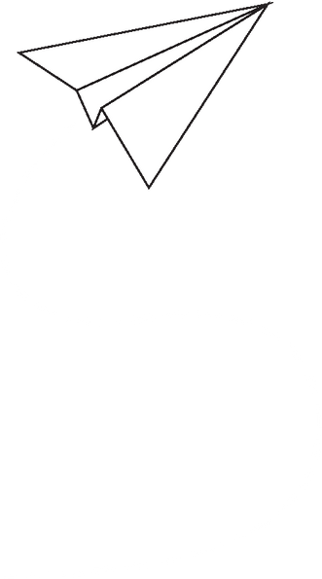


Present Continuous – Structure
  Khẳng định: S + am/is/are + V-ing.
=> Ví dụ: I am studying now.
  Phủ định: S + am/is/are + not + V-ing.
=> Ví dụ: They are not watching TV
  Câu hỏi: Am/Is/Are + S + V-ing?
=> Ví dụ: Are you playing soccer?

Slide 3

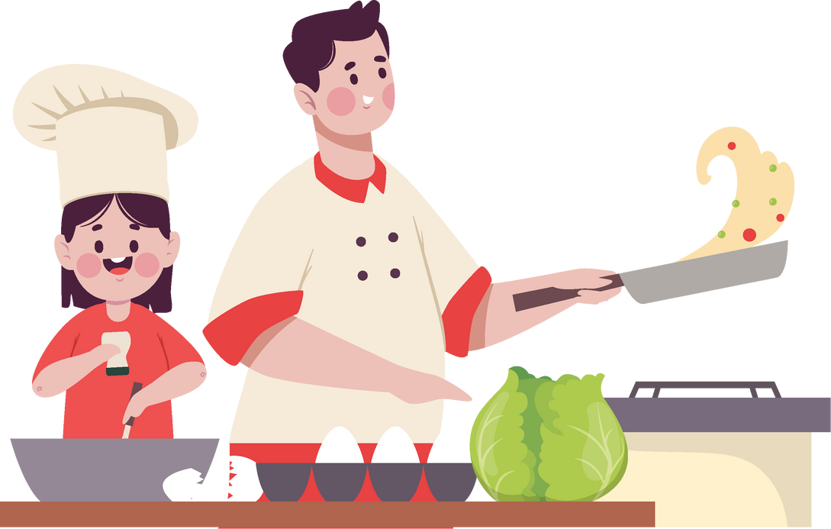

Activities Happening Now
Reading
Cooking
Listening
He is reading a book
We are cooking dinner
She is listening to music

Slide 4
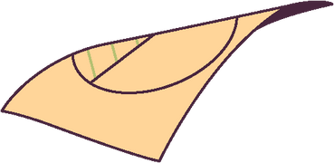



Quick Exercises
Bài tập 1: Điền chỗ trống
  I ___ (am/is/are) studying English.
  They ___ (is/are) not sleeping now.
Bài tập 2: Chọn đáp án đúng
  ___ she cooking dinner?”
A. Is B. Are
  He ___ watching TV at the moment.
A. am B. is

