Slide 1
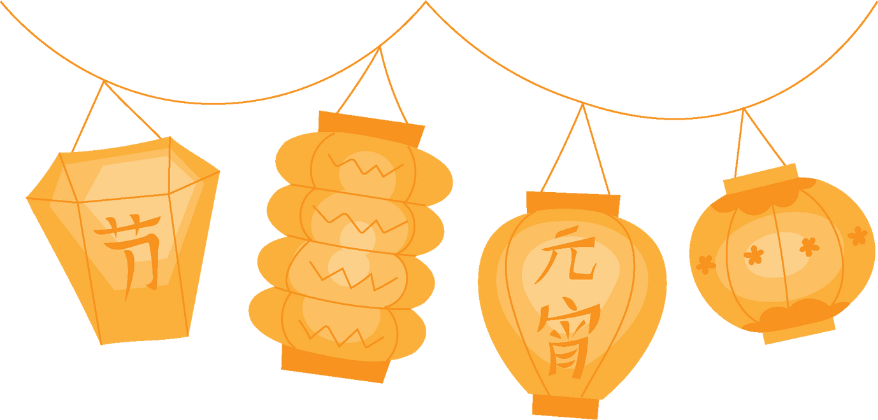
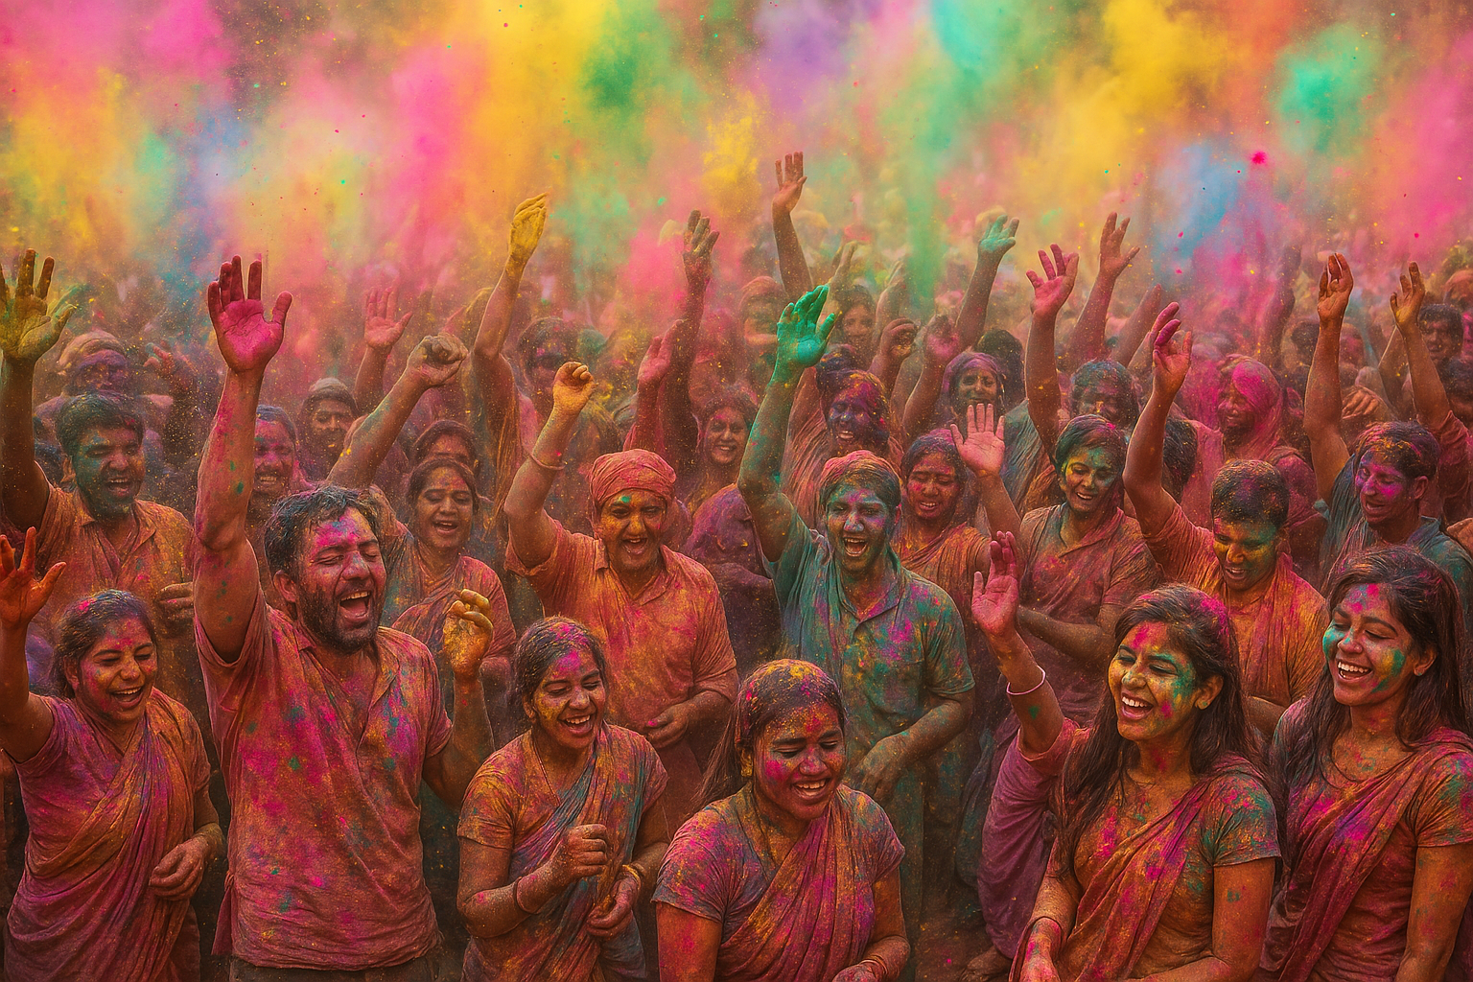

INTERNATIONAL FESTIVALS AND CULTURAL DIVERSITY
Exploring the Power of Unity Through Diversity

Slide 2


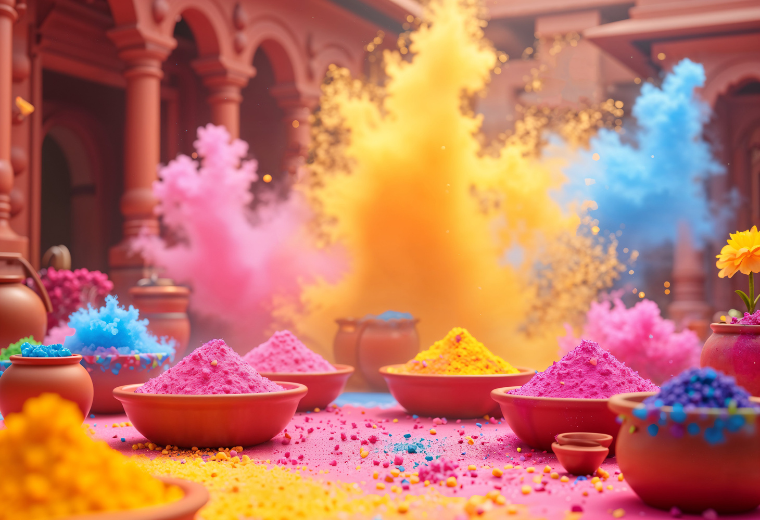

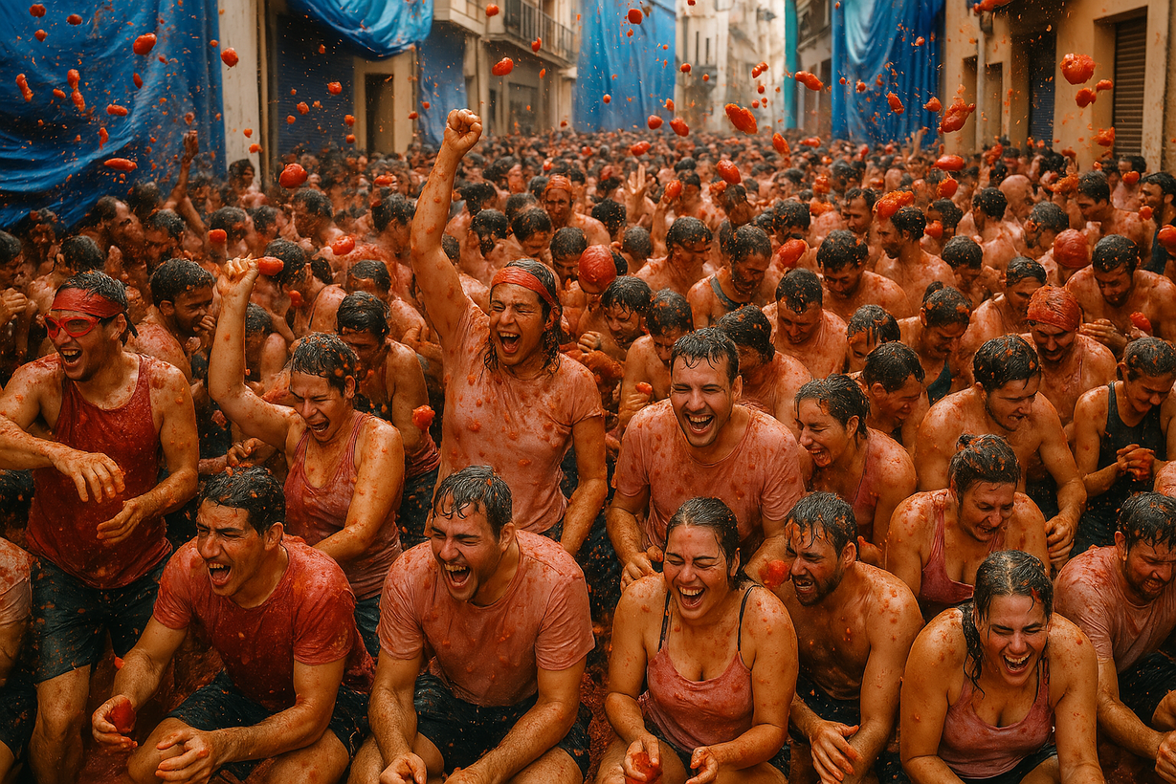



Guess the Festival!
A traditional Indian festival
It takes place in Buñol, Spain

Slide 3
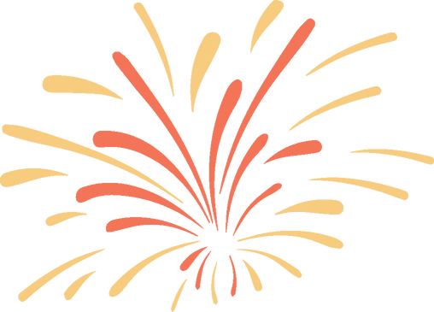
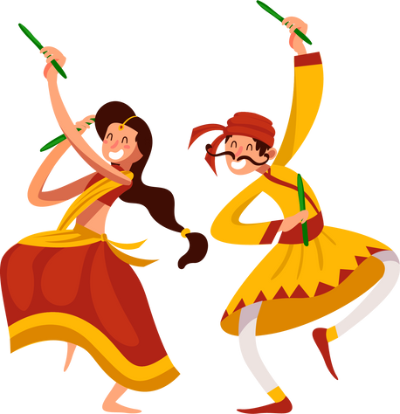

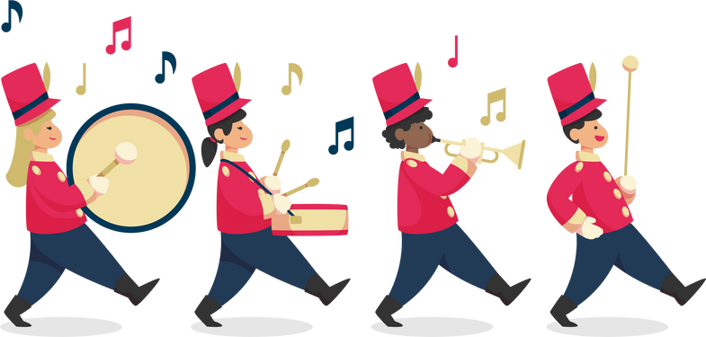
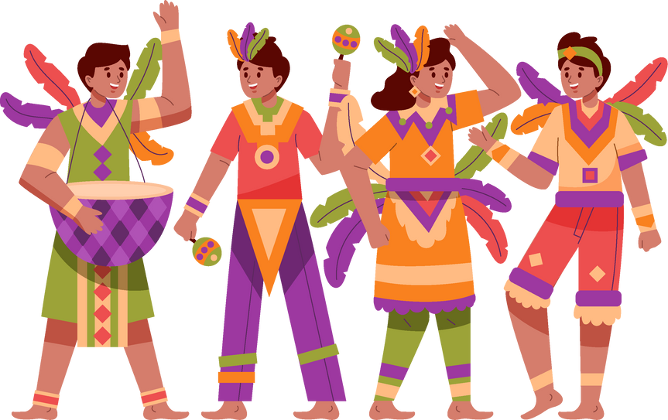

KEY WORDS ABOUT FESTIVALS
Tradition
01
A custom or belief that has continued from the past.
Parade
A public procession with music, dancing, and costumes
02
Ritual
03
A ceremonial act, often with religious or cultural significance

Slide 4

RELATIVE CLAUSES IN CULTURAL CONTEXT
Who
Thường sử dụng làm chủ ngữ, tân ngữ hoặc có thể thay thế cho các danh từ chỉ người.
Cấu trúc: …. N (person) + Who + V + O
Which
Thường sử dụng để làm chủ ngữ, tân ngữ, dùng để thay thế cho các danh từ chỉ vật.
Cấu trúc: ….N (thing) + Which + V + O hoặc ….N (thing) + Which + S + V
Ex: Holi, which is celebrated in India, is known as the Festival of Colors.
Whose
Why
Whose: Dùng để chỉ sự sở hữu của người và vật.
Cấu trúc: …. N (person, thing) + Whose + N + V
Why: Thường sử dụng cho các mệnh đề chỉ lý do
Cấu trúc: …..N (reason) + Why + S + V …
Where
When
Where: Dùng để thay thế từ chỉ nơi chốn
Cấu trúc: ….N (place) + Where + S + V
Dùng thay thế cho các từ chỉ thời gian
Cấu trúc: ….N (time) + When + S + V

Slide 5
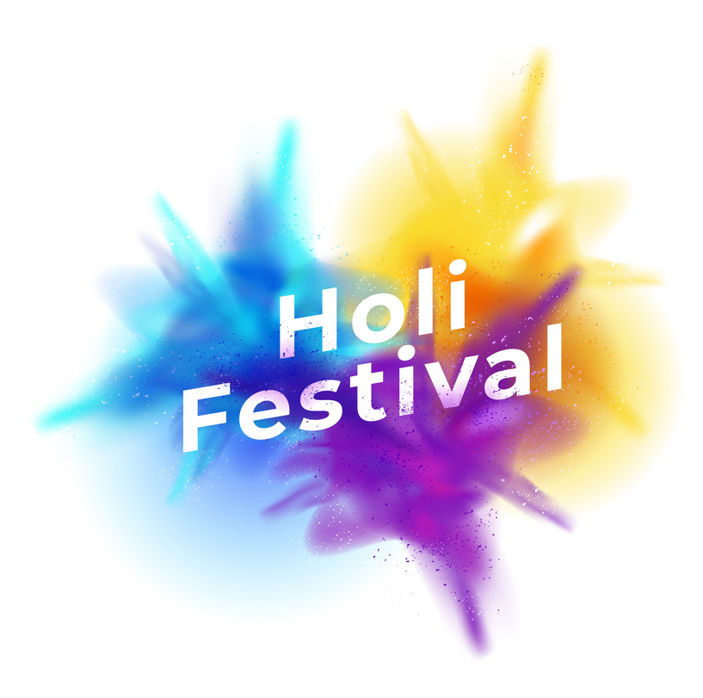

CULTURAL INSIGHT
Holi (India)
Holi is a traditional Indian festival, often called the “Festival of Colors,” which signifies the victory of good over evil. On this day, people throw vibrant colored powder (gulal) and water at each other, dance to festive music, and enjoy sweet treats.
The festival has roots in the ancient story of Prahlad and Holika, symbolizing resilience and joy. Families and friends come together to celebrate, exchange greetings, and forgive past misunderstandings. Streets and neighborhoods burst into a riot of colors, creating an unforgettable atmosphere of excitement and unity.
La Tomatina (Spain)
Diversity in the United States continues to grow, creating both challenges and opportunities for a more inclusive and harmonious future. Diversity in the United States continues to grow, creating both challenges and opportunities for a more inclusive and harmonious future.
With changing demographics and social progress, here are some insights into the future of diversity in the US: Diversity in the United States continues to grow, creating both challenges and opportunities for a more inclusive and harmonious future. With changing demographics and social progress, here are some insights into the future of diversity in the US

Slide 6
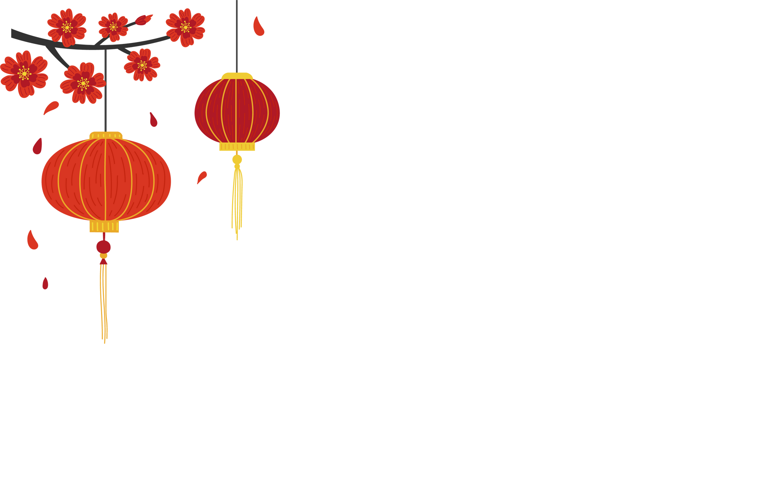
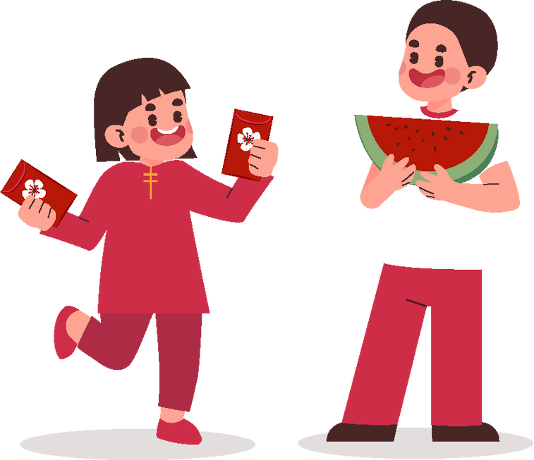
PLAN & PRESENT YOUR FESTIVAL
Groups of 3–4 students: Choose a festival (can think of their own or take a local/foreign festival)
Task:
  Write a paragraph or create a short slide, using vocabulary & relative clauses to introduce.
Suggested content:
  Where/when is it celebrated?
  What activities do people do?
  Why is it special?
Presentation: Each group introduces the festival to the class (2–3 minutes).

