Slide 1





Travel ABROAD

Slide 2

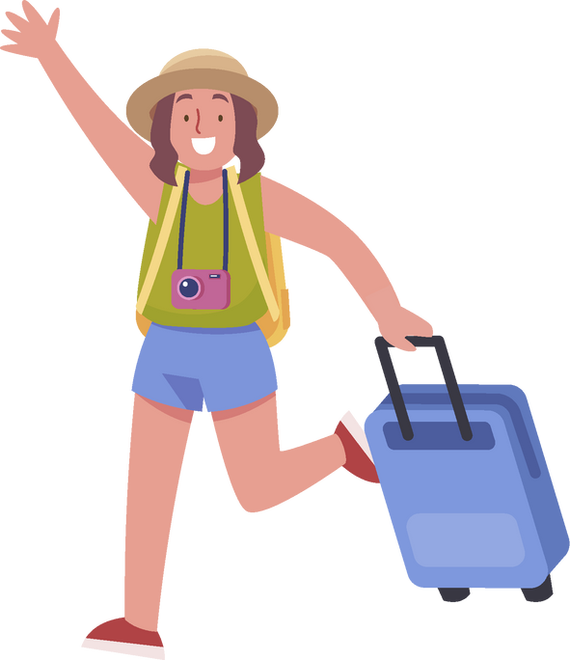







Let’s started
Flag quizzes
01
03
02
04
  Which country is this?
  Have you ever traveled to another city or country?

Slide 3
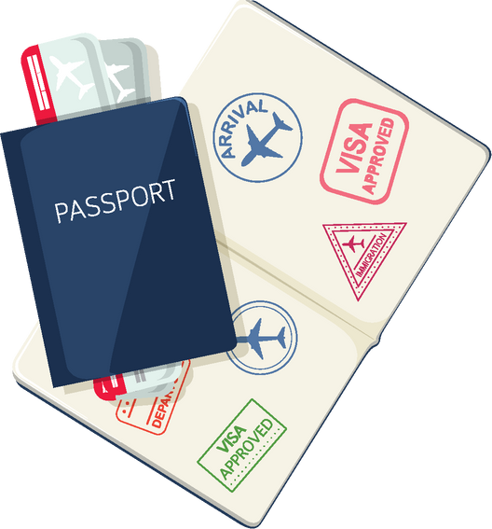
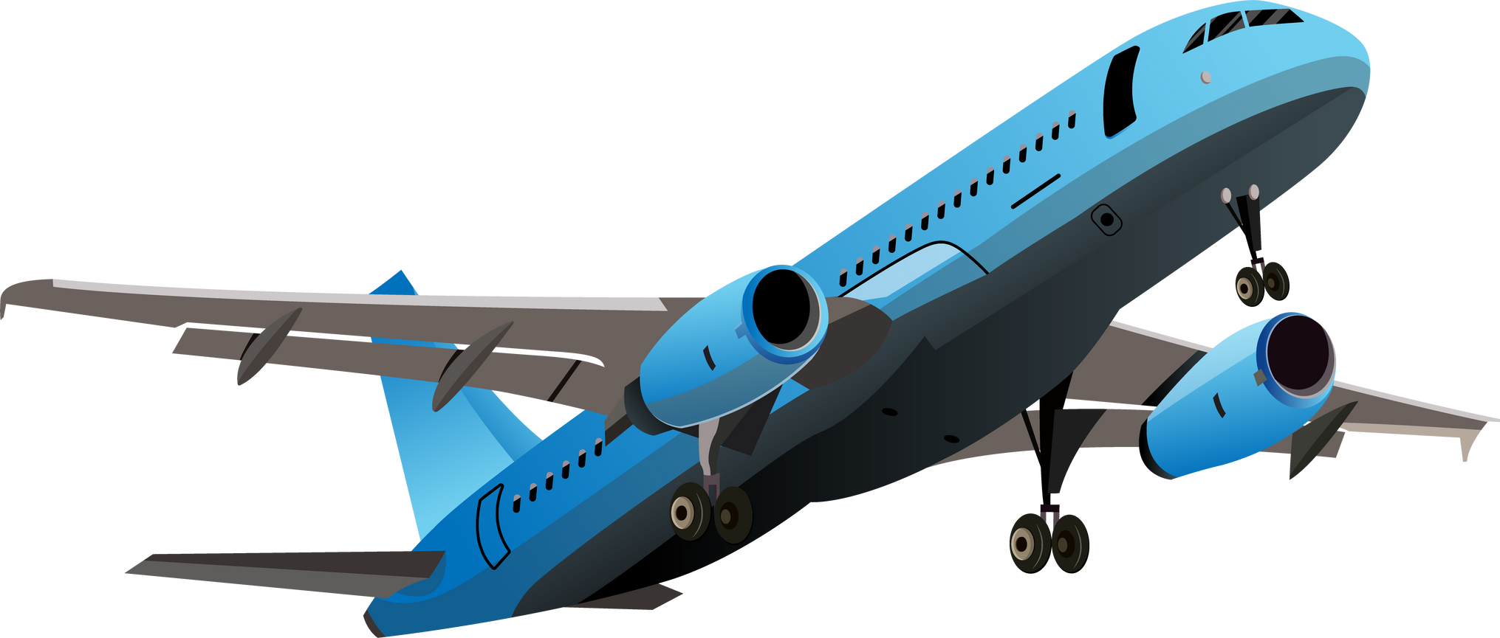

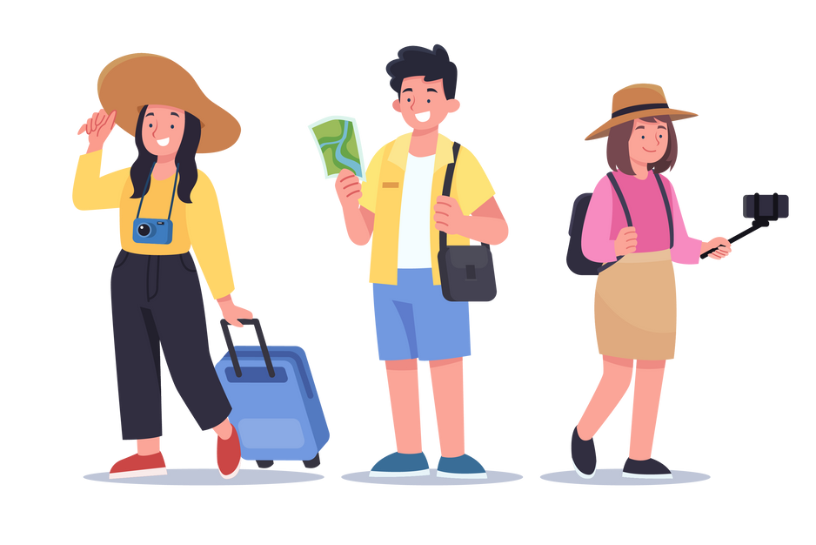



Key Travel Words
Passport
Flight
Hotel
souvenir
visit/travel
Tourist attraction

Slide 4


Grammar: Making Travel Plans
Công thức: S+ am/is/are + going to + V
For example:
  I’m going to visit Ha Long Bay next summer.
  They are going to book a hotel in Hanoi.
  Where are you going to…?
  When are you going to…?

Slide 5


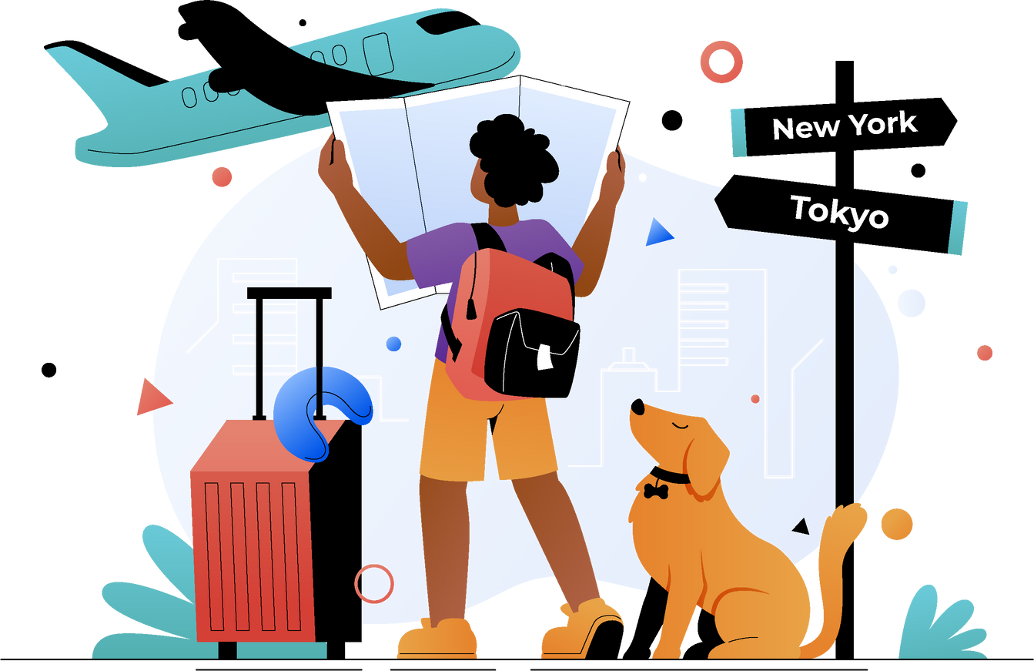

Let’s Practice!
1: Fill in the blanks
  I __ going to visit Japan next year
  We __ going to book a hotel in Tokyo.
2: Mini Role-play
Một bạn hỏi – một bạn trả lời về kế hoạch du lịch.
  Q: Where are you going to travel?
  A: I’m going to travel to Korea.
  Q: What are you going to do there?
  A: I’m going to visit Seoul Tower.

Slide 6



Global Greetings & Travel Tips
Cultural Insight
Greetings:
  Ở Nhật Bản: Cúi chào (bow) là thông lệ.
  Ở Mỹ: Bắt tay, eye contact, cười thân thiện.
  Ở Thái Lan: Wai (chắp tay trước ngực).
Travel Tips:
  Check the weather before you go.
  Learn some basic local phrases.
  Respect local customs and cultures.

Slide 7






Thank You

